Slide 1
Agenda
Administrative
Earned Value Management (EVM)

Slide 2
Monitoring and Controlling the Project
Earned Value Management (EVM)

Slide 3
Monitoring and Controlling the Project
Initiating
Planning
Executing
Monitoring and Controlling
Closing

Slide 4
Generic Project Control Process
1. Set a Baseline Plan
2. Measure Progress and Performance
3. Compare Actual against Plan
4. Take Action

Slide 5
Measuring Project Performance
Performance is Measured against Baselines
Schedule
Cost
Scope
Measurement in Isolation is Problematic
Why?

Slide 6
Earned Value Management (EVM)
Realistic Estimate of Performance against a time-phased budget
Measures how much real progress is made, not just how much effort is expended
Earned Value Management Criteria
1. Define the Project Scope (WBS)
2. Plan and schedule the project (CPM)
3. Form cost account plans and budget them to specific functions
4. Establish and maintain a performance measurement baseline (cost baseline)
5. Monitor project performance and forecast the final results (earned value analysis)

Slide 7
Three Major Components of EVM
Planned Value (PV)
Authorized cost for the scheduled work on the project or a project activity up to a given point on the timescale. Also called Budgeted Cost of Work Scheduled (BCWS)
Cost Baseline
Earned Value (EV)
The value of the actually performed work expressed in terms of the approved budget for a project or a project activity for a given time period. Also called Budgeted Cost of Work Performed (BCWP).
What the project really accomplished
Actual Cost (AC)
Total cost actually incurred until a specific point on the timescale in performing the work on a project. Actual Cost of Work Performed (ACWP).
What the project spent or burned to accomplish what it did

Slide 8
EVM Measures
Budget at Completion (BAC) = Planned Budget
Earned Value (EV) = BAC * (work completed / total work required)¹
Planned Value (PV) = BAC * (time passed / total schedule time)¹
Cost Variance (CV) = EV - AC
Schedule Variance (SV) = EV – PV
Estimated Cost at Completion (ECAC) = BAC *( AC / EV)
Estimated Time at Completion (ETAC) = Original Time * (PV/ EV)
Cost Performance Index (CPI) = (EV / AC)
Schedule Performance Index (SPI) = (EV / PV)
Critical Ratio (CR) = SPI x CPI
¹ Assumes uniform distribution of work.

Slide 9
Practice Problem
Assume that you are the project manager for the construction of a 15-mile road. Further, assume that the work is uniformly distributed over 12 weeks. The total approved budget for the project is $600,000. At the end of the first three weeks of work, $160,000 has been spent, and five miles of road have been completed. What is the earned value of the project at the end of the first three weeks?
A. $160,000
B. $200,000
C. $150,000
D. $600,000

Slide 10
Practice Problem
Assume that you are the project manager for the construction of a 15-mile road. Further, assume that the work is uniformly distributed over 12 weeks. The total approved budget for the project is $600,000. At the end of the first three weeks of work, $160,000 has been spent, and five miles of road have been completed. What is the planned value of the project at the end of the first three weeks?
A. $160,000
B. $200,000
C. $150,000
D. $600,000

Slide 11
Practice Problem
Assume that you are the project manager for the construction of a 15-mile road. Further, assume that the work is uniformly distributed over 12 weeks. The total approved budget for the project is $600,000. At the end of the first three weeks of work, $160,000 has been spent, and five miles of road have been completed. What is the cost variance?
A. $40,000
B. $50,000
C. -$40,000
D. $120,000
E. -$10,000

Slide 12
Practice Problem
Assume that you are the project manager for the construction of a 15-mile road. Further, assume that the work is uniformly distributed over 12 weeks. The total approved budget for the project is $600,000. At the end of the first three weeks of work, $160,000 has been spent, and five miles of road have been completed. What is the schedule variance?
A. $40,000
B. $50,000
C. Three weeks
D. Twelve weeks

Slide 13
Practice Problem
Assume that you are the project manager for the construction of a 15-mile road. Further, assume that the work is uniformly distributed over 12 weeks. The total approved budget for the project is $600,000. At the end of the first three weeks of work, $160,000 has been spent, and five miles of road have been completed. What is the Estimated Time at Completion (ETAC)?
A. $40,000
B. $50,000
C. Three weeks
D. Nine weeks
E. Twelve weeks

Slide 14
Practice Problem
Assume that you are the project manager for the construction of a 15-mile road. Further, assume that the work is uniformly distributed over 12 weeks. The total approved budget for the project is $600,000. At the end of the first three weeks of work, $160,000 has been spent, and five miles of road have been completed. What is the Estimated Cost at Completion (ECAC)?
A. $150,000
B. $200,000
C. $480,000
D. $600,000
E. $750,000

Slide 15
Exercise
You have a project to build a new fence. The fence is a four sided square. Each side is to take one day to build and is budgeted for $1,000 per side. The sides are planned to be completed one after the other. Today is the end of day three.
Using the project status chart listed below, calculate PV, EV, AC, BAC, CV, SV, ECAC, ETAC, Cost Variance at Completion, Schedule Variance at Completion
Activity | Status at End of Day 3
Side 1 | Complete, spent $1,000
Side 2 | Complete, spent $1,200
Side 3 | 50% done, spent $600
Side 4 | Not yet started

Slide 16
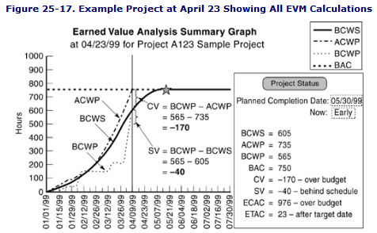
Example Showing All EVM Calculations
PV
AC
EV
AC
PV
PV
AC
EV
EV

Slide 17
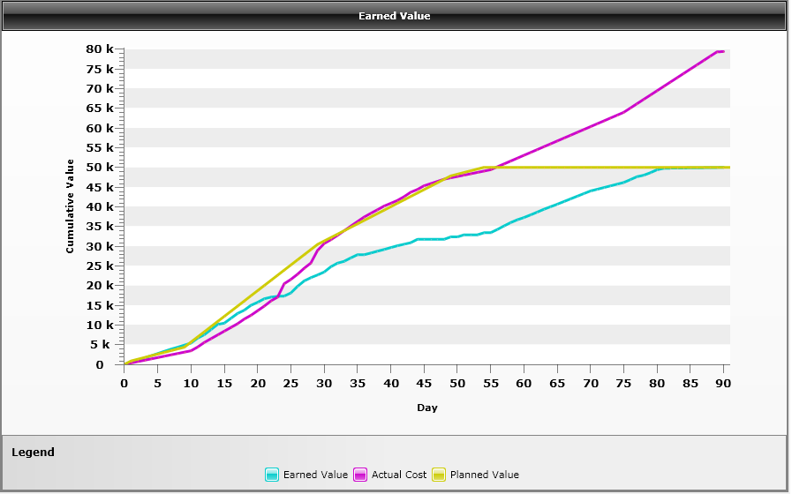
At Day 15, how is the project performing?

Slide 18
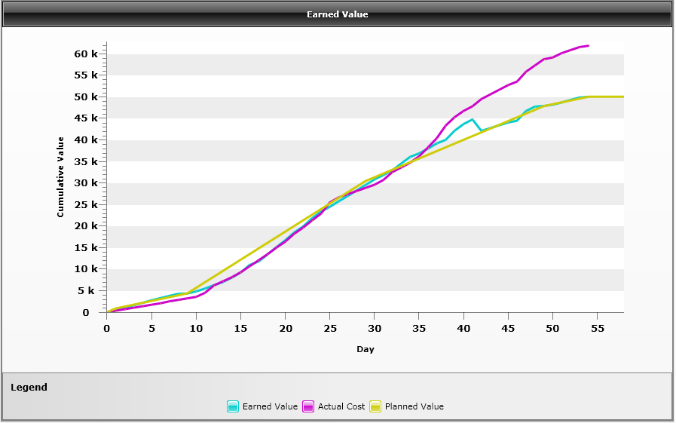
At day 15, how is the project performing?

Slide 19
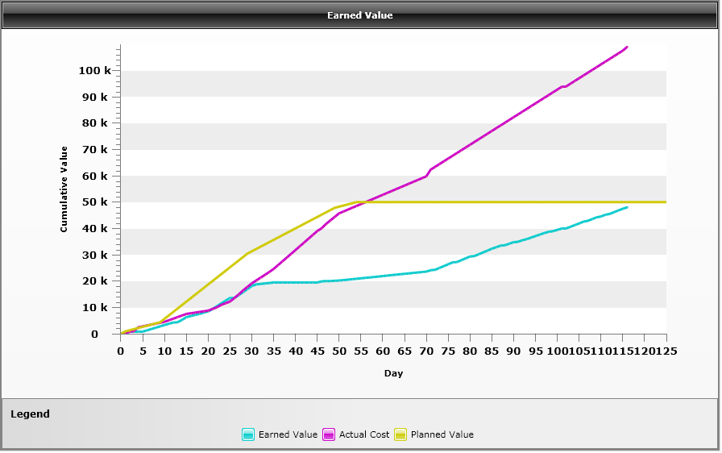
At day 45, how is the project performing?

Slide 20
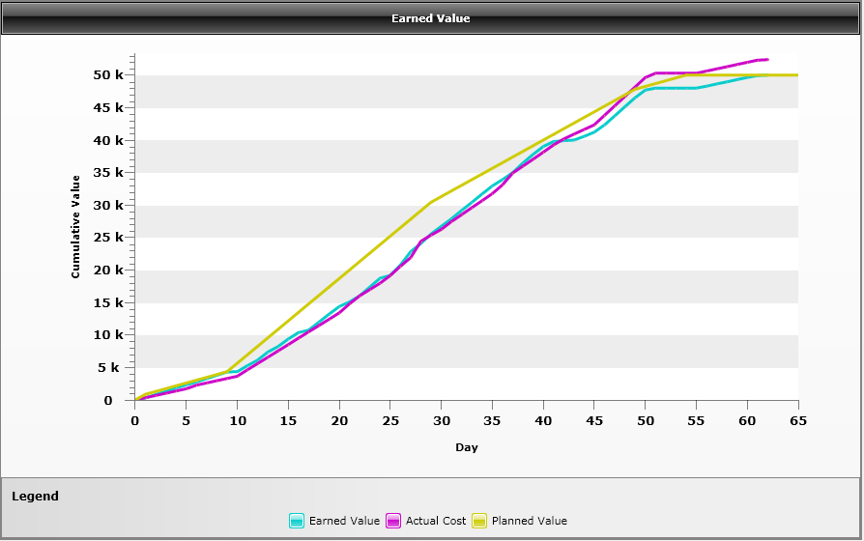
Good or Bad?

Slide 21
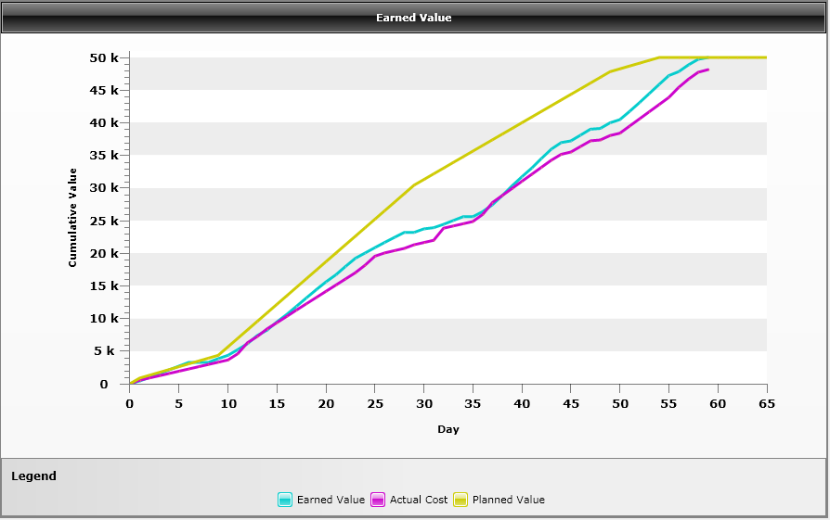
Good or Bad?

Slide 22
Earning Rules
0/100
0% of value is earned when activity is started
100% of value is earned when activity is completed
50/50
50% of value is earned when activity is started
50% of value is earned when activity is completed
Proportionality Rule
Divides actual task time-to-date by the scheduled time for the task [or actual task cost-to-date by total budgeted task cost] to calculate percent complete

Slide 23
50/50 Rule
Task | Predecessor | Budget | Duration (Weeks) | Actual Cost | Task Started | Task Finished
A | - | $4,000 | 2 | $4,000 | Yes | Yes
B | A | $8,000 | 4 | $8,000 | Yes | No
C | A | $15,000 | 3 | $15,000 | Yes | No
D | C | $10,000 | 2 | $0 | No | No
E | B, D | $12,000 | 5 | $0 | No | No
The following project is at the end of its 3rd week. Using the 50/50 rule calculate PV, AC, EV, SV and CV. Assume all tasks were planned to start as soon as possible and the the “% Complete” values for EV are from the workers actually doing the tasks.

Slide 24
Proportionality Rule
Task | Predecessor | Budget | Duration (Weeks) | Actual Cost | % Complete
A | - | $4,000 | 2 | $4,000 | 100%
B | A | $8,000 | 4 | $8,000 | 50%
C | A | $15,000 | 3 | $15,000 | 33%
D | C | $10,000 | 2 | $0 | 0%
E | B, D | $12,000 | 5 | $0 | 0%
The following project is at the end of its 3rd week. Using the proportionality rule (actual task time-to-date by the scheduled time) calculate PV, AC, EV, SV and CV. Assume all tasks were planned to start as soon as possible and the the “% Complete” values for EV are from the workers actually doing the tasks.

Slide 25
MS Project
Task | Predecessor | Budget | Duration (Weeks) | Actual Duration | Actual Cost | % Complete
A | - | $4,000 | 2 | 2 | $4,000 | 100%
B | A | $8,000 | 4 | 6 | $12,000 | 100%
C | A | $15,000 | 3 | 6 | $30,000 | 100%
D | C | $10,000 | 2 | 1 | $5,000 | 10%
E | B, D | $12,000 | 5 |  | $0 | 0%
The following project is at the end of its 9th week. Using MS Project calculate PV, AC, EV, SV and CV. Assume all tasks were planned to start as soon as possible and the the “% Complete” values for EV are from the workers actually doing the tasks.

